Slide 1
MACHINE LEANING PROJECT PRESENTATION
By
Archit Sagar (R21EJ006)
Md Kaif Mustafa (R21EJ020)
Satyam Kumar (R21EJ029)
Gagandeep Gautam (R21EJ012)
School of Computing and Information Technology

Slide 2
Visualization and Forecasting of Stocks
This is to certify that the mini project entitled “Visualization and Forecasting of Stocks” is a Bonafide work carried out by Archit Sagar(R21EJ006),Md Kaif Mustafa(R21EJ020),Satyam Kumar(R21EJ029),Gagandeep Gautam(R21EJ012) respectively in partial fulfilment of 5thsemester of CSIT program of Bachelor of Technology, REVA University during the academic year 2023-24. It is certified that all the corrections/suggestions indicated for internal assessment have been incorporated in the report deposited in the school library. The mini-project report has been approved as it satisfies the academic requirements.

Slide 3
Abstract
This project revolves around the development of a stock analysis and visualization tool using the Dash framework.
The primary goal is to create an interactive web application that allows users to explore stock data, visualize stock prices over time, and generate predictions for future closing prices

Slide 4
Introduction
Welcome to the presentation on the creation of a Visualization and Forecasting of Stocks, designed to empower users with insightful tools for understanding and forecasting stock market trends.
In this project, we explore the development of an interactive web application using the Dash framework, incorporating key functionalities to enhance the user's experience and decision-making process.

Slide 5
Objectives and Problem Definition
Objectives:
Create a user-friendly Stock Analysis and Visualization Dashboard.
Provide real-time retrieval of stock information, including logos, names, and summaries.
Visualize historical stock prices over specified date ranges for trend analysis.
Problem Definition:
Investors grapple with data overload in the dynamic stock market environment.
Technical analysis complexities hinder accessibility for individuals with limited financial knowledge.
Uncertainty in decision-making due to a lack of insights into potential future stock movements.

Slide 6
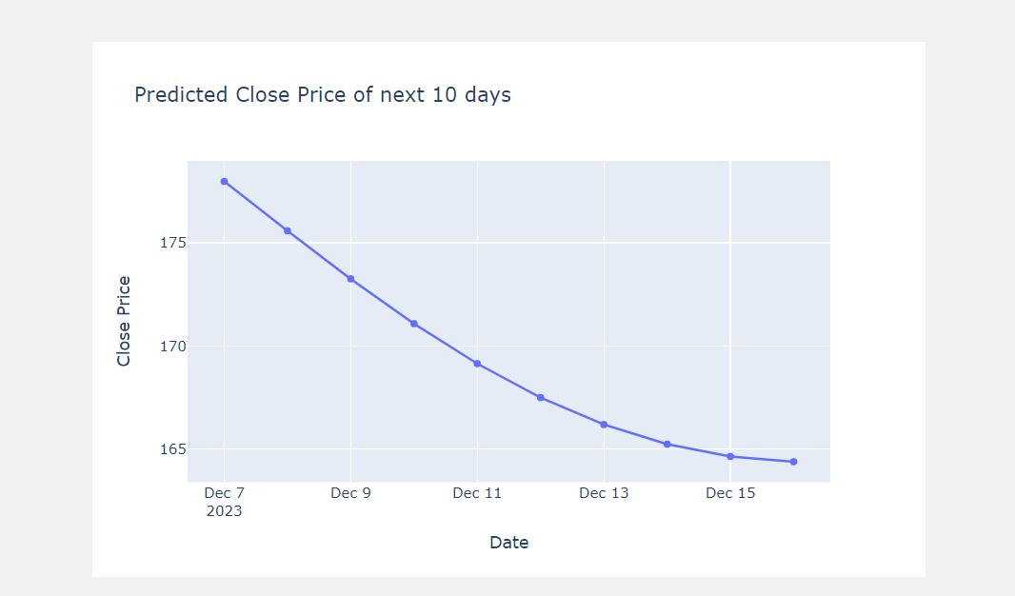
System Design

Slide 7
System Requirements
Python 3.x
Dash Framework
Pandas
Plotly
yfinance
Scikit-Learn

Slide 8
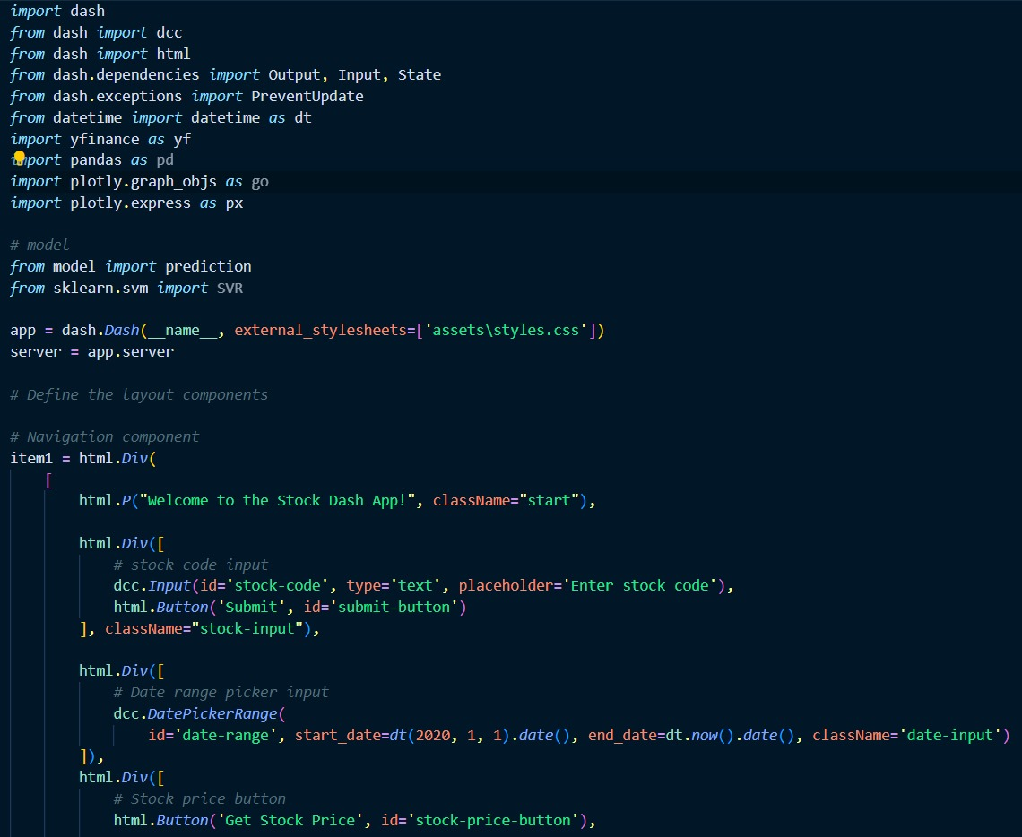
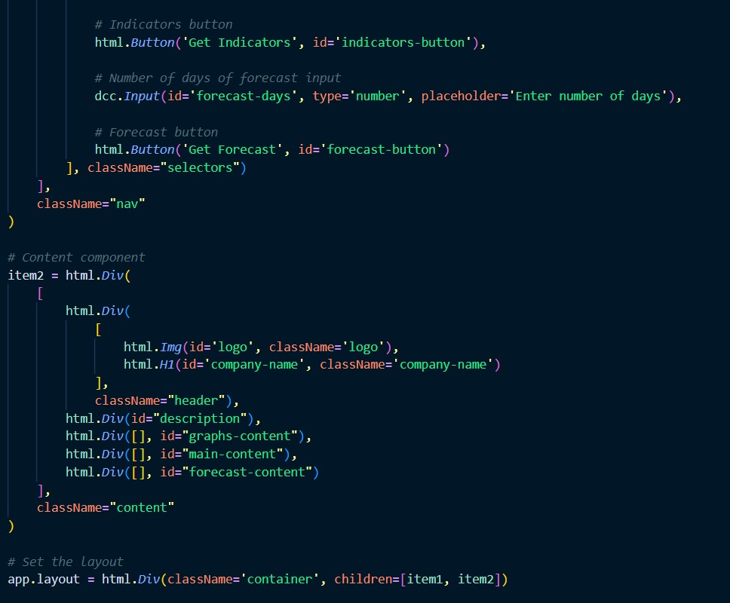
Implementation

Slide 9
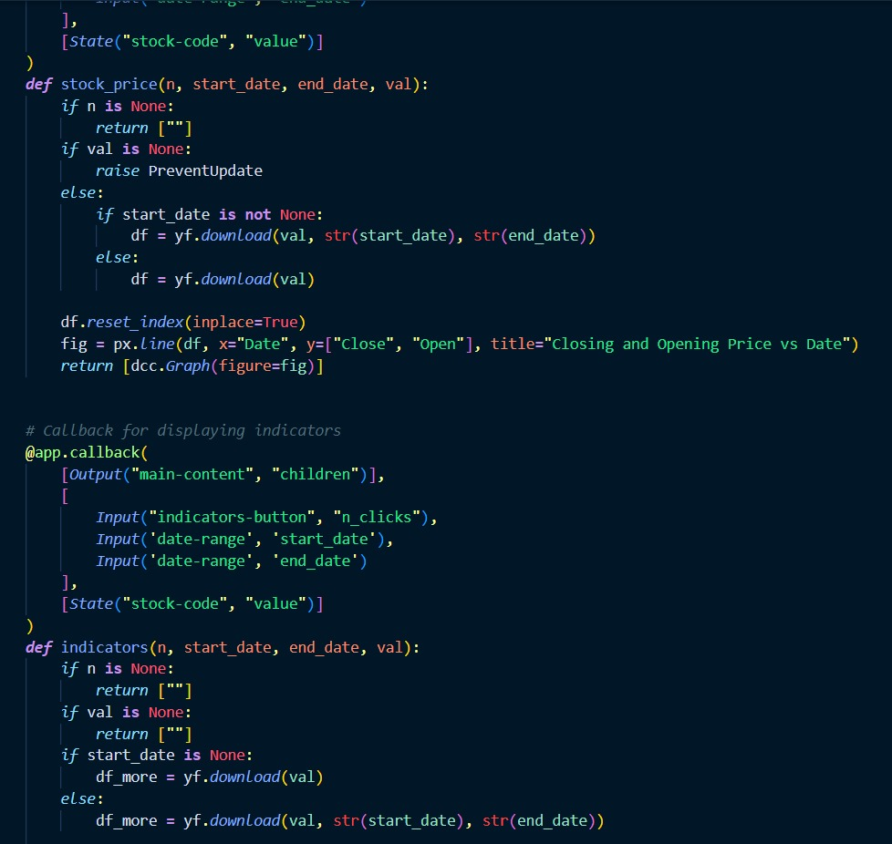
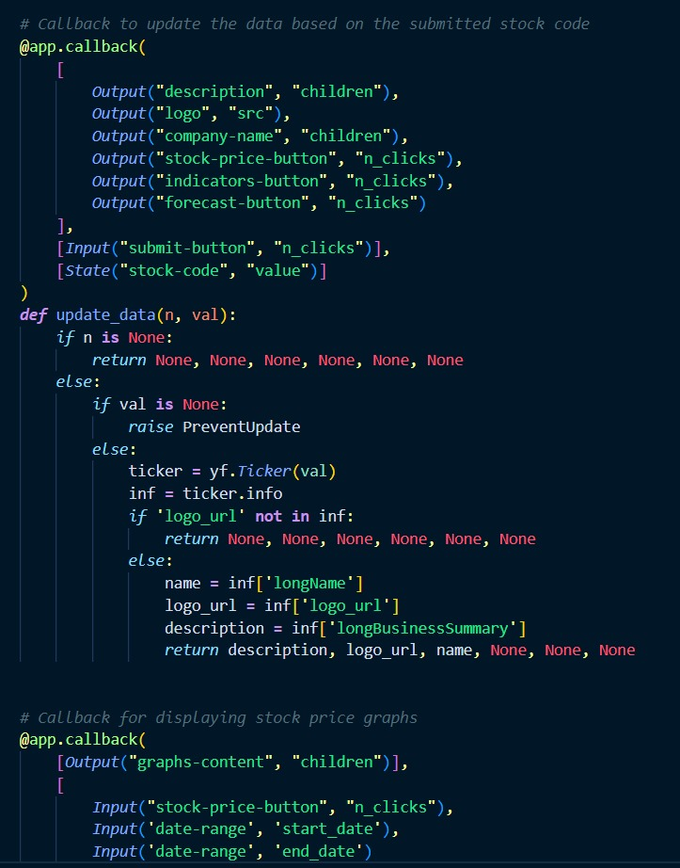
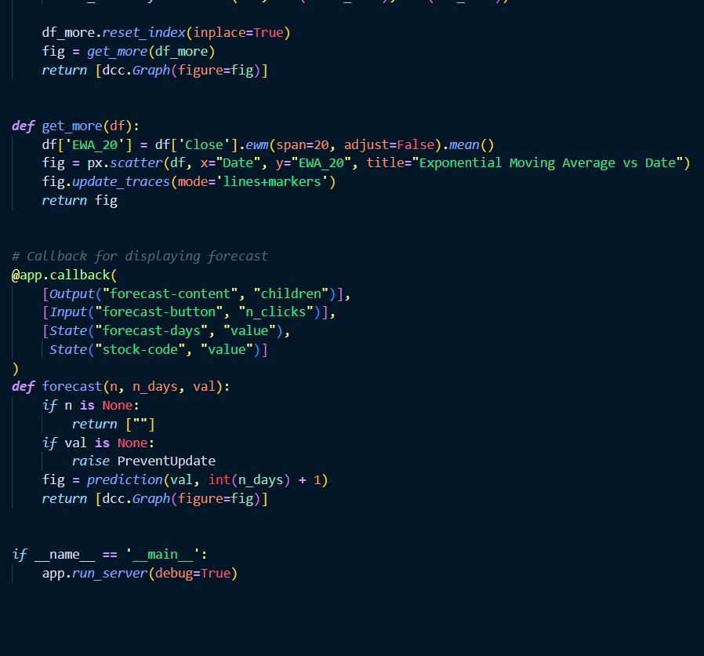
Implementation

Slide 10
Implementation

Slide 11
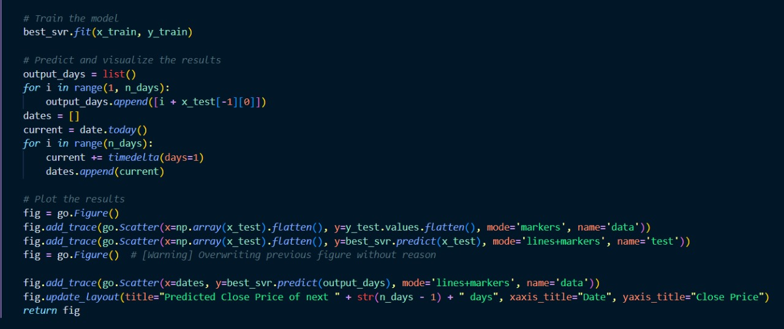
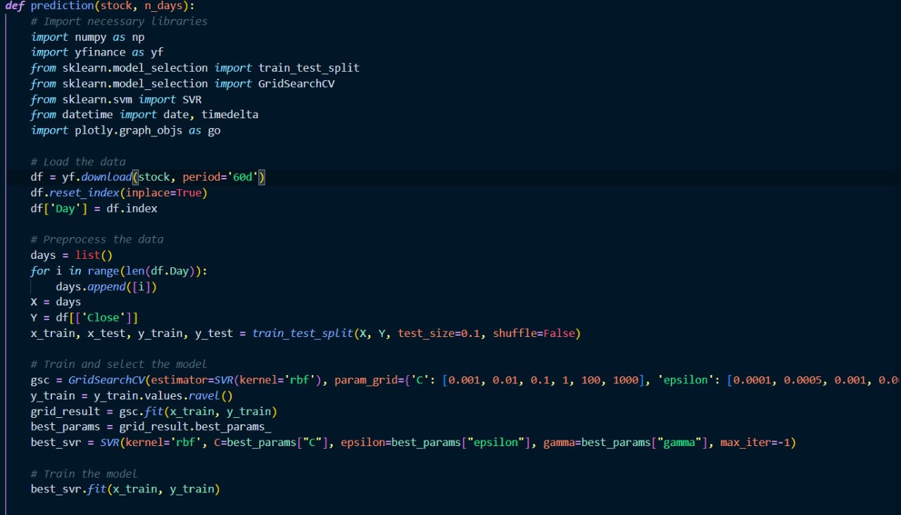
Implementation

Slide 12
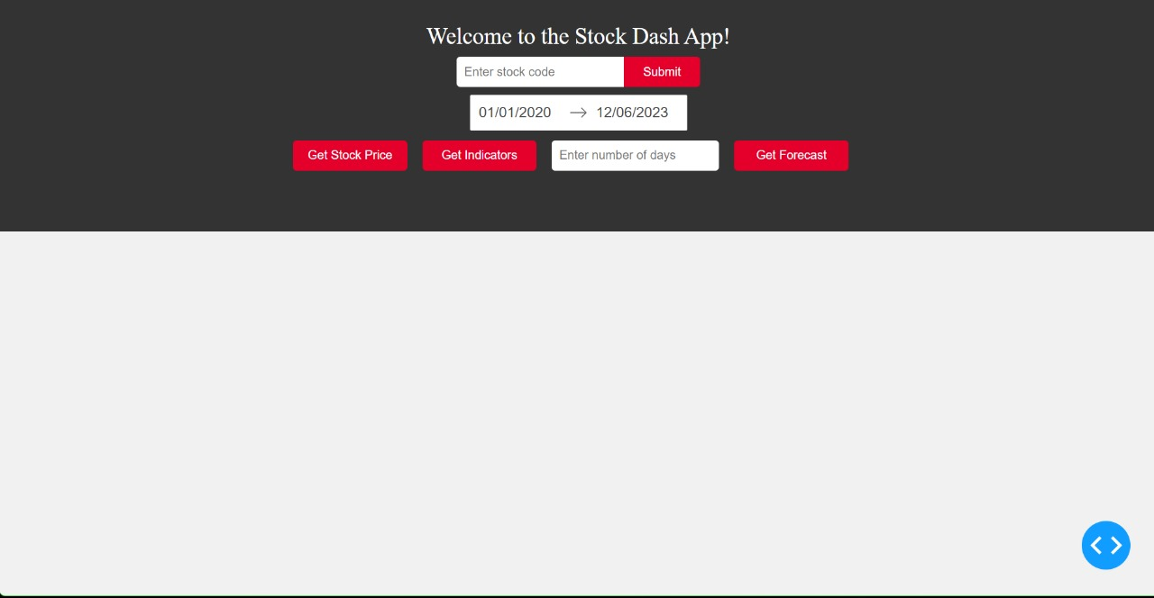
Expected Results

Slide 13
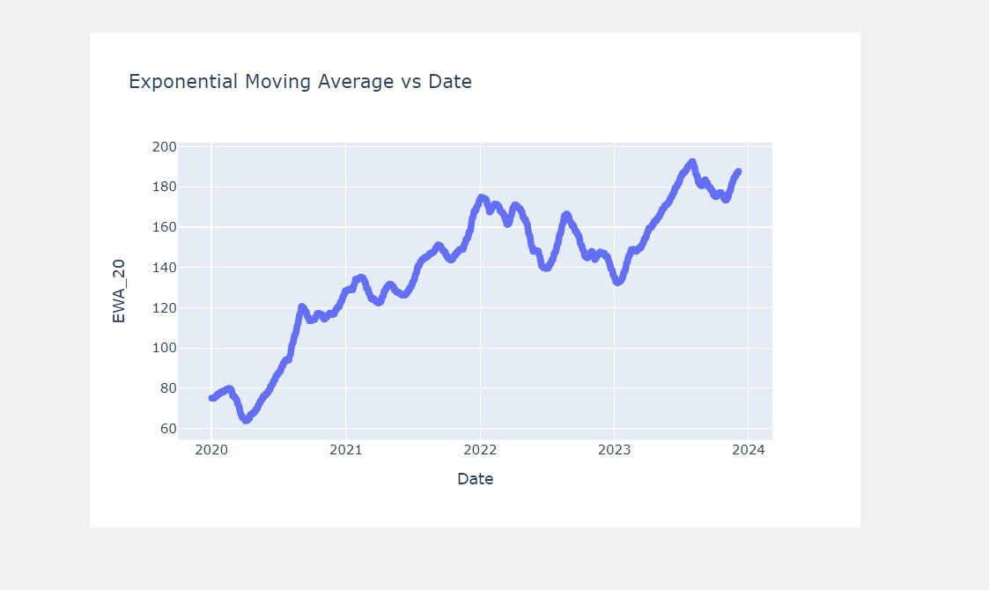
Expected Results

Slide 14
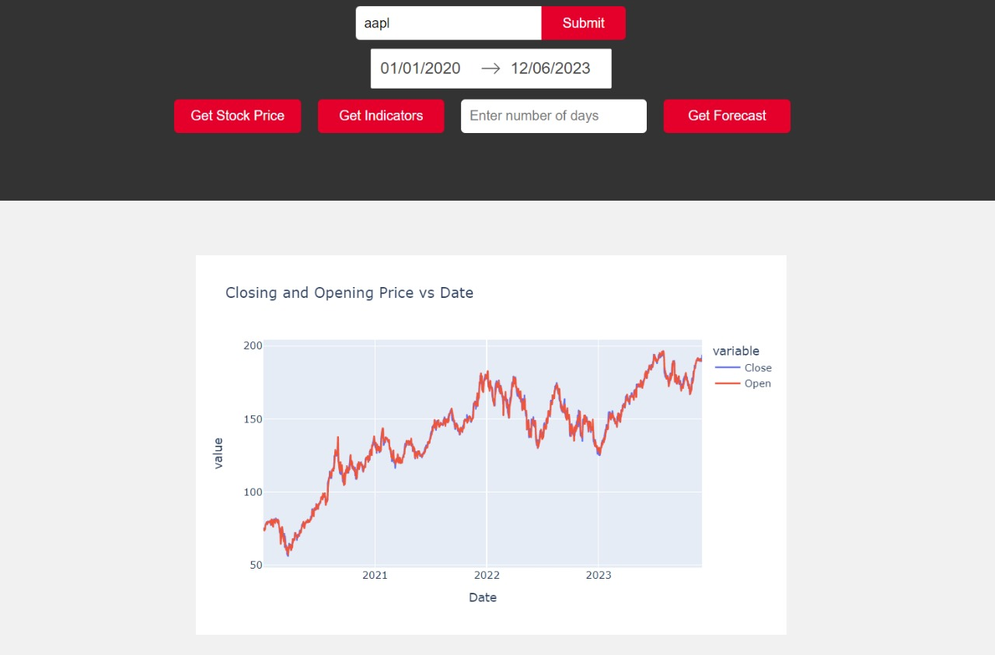
Expected Results

Slide 15
Conclusion
the development of our Stock Analysis and Visualization Dashboard represents a significant step forward in empowering users to navigate the complexities of the stock market with confidence and insight.
The integration of cutting-edge technologies, including Python, Dash, and machine learning with Support Vector Regression (SVR), creates a powerful toolset for both novice investors and experienced traders.

Slide 16
References
Dash Framework
Pandas Library
yfinance Library
Scikit-Learn Library
Python Programming Language
Support Vector Regression (SVR)

Slide 17
THANK YOU

